Slide 1
TRUSTS 101: IN GOD WE TRUST – ALL OTHERS “SHOW ME THE DOCUMENTS” Clinton M. Goos March 16, 2015

Slide 2
Trusts 101 – The “Has”
This presentation provides a snapshot of the following regarding trusts:
Trust fundamentals-parties, creation, types, etc.
Focus is on express, private trusts
Transfer of interest basics
Trust administration basics
Modification and termination of trust
Focuses on the revenue side

Slide 3
Trusts 101 – The “Has Nots”
This presentation does not:
Constitute legal advice (always consult counsel for legal advice)
Provide an in-depth review of trust issues

Slide 4
Why are Trusts Relevant?
State law generally requires that:
“. . . [P]ayments of proceeds derived from the sale of oil, gas, or associated products shall be paid by a payer to a payee commencing not later than six months after the end of the month in which production is first sold.” C.R.S. 34-60-118.5(2)(a)(emphasis added).
AR = A.C.A. § 15-74-640

Slide 5
Why are Trusts Relevant?
We work for the “payers” on proceeds of production
“Payer” means the first purchaser of oil, gas, or associated products from a well in Colorado unless the first purchaser has entered into an agreement under which the operator of a well has accepted responsibility for making payment to payees, in which case operator shall be the payer. C.R.S. 34-60-118.5(1)(b).

Slide 6
Why are Trusts Relevant?
As “payer” we must pay the appropriate “payee(s)”
“Payee” means “any person or persons legally entitled to payment from proceeds derived from the sale of oil, gas, or associated products from a well in Colorado, but shall not include those interest owned by the state of Colorado.” C.R.S. 34-60-118.5(1)(a)

Slide 7
Why are Trusts Relevant?
Most other producing states have similar laws:
Arkansas = A.C.A. § 15-74-640
Kansas = K.S.A. 55-1614
Louisiana = Article 123 of the Mineral Code
Mississippi = Miss. Code Ann. 53-3-39
Montana = M.C.A § 82-10-103
New Mexico = N.M. Stat. § 70-10-3
North Dakota = N.D. Cent. Code § 47-16-39.1
Oklahoma = 52 O.S. § 570.10
Texas = Nat. Res. Code Sec. 91.401
Utah = U.C.A. Section 40-6-9
Wyoming = W.S. § § 30-5-301 through 30-5-303

Slide 8
Why are Trusts Relevant?
Trusts are often the payees on proceeds
Important to know basic information about how trusts are created, amended, and terminated, so we can meet our statutory obligation to pay the payee

Slide 9
Trusts 101: What is a trust?
Legal definition:
1. The right, enforceable solely in equity, to the beneficial enjoyment of property to which another person holds the legal title; a property interest held by one person (the trustee), at the request of another (the settlor) for the benefit of a third party (the beneficiary). For a trust to be valid, it must involve specific property, reflect the settlor’s intent, and be created for a lawful purpose. Black’s law dictionary, 8th Ed., 1546.

Slide 10
Trusts 101: What is a trust?
Legal definition (continued):
2. A fiduciary relationship regarding property and charging the person with title to the property with equitable duties to deal with it for another’s benefit; the confidence placed in a trustee, together with the trustee’s obligations toward the property and the beneficiary. A trust arises as a result of a manifestation of an intention to create it. Black’s law dictionary, 8th Ed., 1546.

Slide 11
Trusts 101: What is a trust?
Simple definition:
A trust is an arrangement whereby property is transferred with the intention that it is administered by a trustee for the benefit of another

Slide 12
Trusts 101: Types of Trusts
Express Trusts – A trust created with the settlor’s express intent, usually in writing
Resulting Trusts – Arise from the presumed intention of the owner of property
Constructive Trusts – Are an equitable remedy in cases involving wrongful conduct and unjust enrichment

Slide 13
Trusts 101: Types of Trusts – Express Trusts
Express Trusts:
Arise from the expressed intention of the owner of property to create the relationship with respect to the property
What we generally work with in the oil and gas context

Slide 14
Trusts 101: Types of Trusts – Express Trusts
Two types of Express Trusts
Private Trusts:
Created for the financial benefit of certain, ascertainable persons, rather than for the public benefit (e.g., a trust “To T in trust for my husband, and at his death to my children”)
2) Charitable Trusts:
Created for the benefit of an indefinite class of persons or the public in general (e.g., a trust “To T in trust for needy students in the Equine Science Therapeutic Riding Program at Colorado State University”)

Slide 15
Express Trusts – How are they created?
Generally created in one of three ways:
Express trust created by declaration of trust by property owner stating he holds the property in trust, as trustee for another person
Inter vivos trust (sometimes referred to as a “living trust”) is also created by transfer of the property by the settlor during his lifetime
Testamentary trust created by will that takes effect when the settlor (testator) dies

Slide 16
Trusts 101: Elements of a Private Trust
Intent: Must have evidence of the demonstrated intent of the settlor
Corpus: Must have trust property
Beneficiary: Must have a beneficiary capable of enforcing the trust

Slide 17
Trusts 101: The Parties to a Trust
Trustor/Settlor
Beneficiaries
Trustee

Slide 18
Trusts 101: Parties to a Trust – Trustor/Settler
The testator or grantor who creates the trust is called the trustor or settlor
The trustor/settlor is similar to the grantor on a deed or the assignor on an assignment

Slide 19
Trusts 101: Parties to a Trust - Beneficiaries
Beneficiaries hold equitable title to the trust property
Trust must have beneficiaries to be valid (Exceptions where a trust may not have beneficiaries are charitable trusts-where the beneficiaries are indefinite, but the trust can be enforced by the state attorney general-and honorary trusts-e.g., trusts for animals or to maintain graves.)

Slide 20
Trusts 101: Parties to a Trust – Trustee
The party that manages the trust property
May be an individual, or may be an institutional trustee
Although the trustee is essential to the operation of a trust, once a trust is established, it will not fail merely because of the trustee’s death, incapacity, resignation, or removal

Slide 21
Trusts 101: Trustee’s Duties - Summary
Generally, a trustee’s duties are to protect and preserve the trust property and to ensure that it is employed solely for the beneficiary and in accordance with the directions contained in the trust instrument.

Slide 22
Trusts 101: Trustee’s Duties
Duty to Administer
Duty of Loyalty – No Self Dealing
Duty to Report
Duty to Separate Trust Property and Keep Records – No Commingling
Duty to Enforce Claims and Defend Trust from Attack
Duty to Preserve Trust Property and Make it Productive

Slide 23
Trustee’s Duty to Administer
Trustee has a duty to administer the trust in good faith and in a prudent manner, according to the terms and purposes of the trust instrument and solely in the beneficiaries’ interests.
If there is more than one beneficiary, the trustee must act impartially

Slide 24
Trustee’s Duty of Loyalty – No Self-Dealing
Absent court approval or a trust provision allowing it, a trustee cannot enter into any transaction in which she is dealing with the trust in her individual capacity.
The trustee’s personal interest in a transaction might affect his judgment as to whether the price is a fair one or whether the asset should be sold at all.
Trustee owes a duty of undivided loyalty

Slide 25
Trustee’s Duty to Report
Trustee must inform the beneficiaries of trustee’s name, address, and telephone number
Trustee must respond to beneficiaries’ requests for information about administration
Trustee must provide the beneficiaries a copy of the trust instrument if requested
Trustee must furnish an annual accounting

Slide 26
Trustee’s Duty to Preserve and Protect Trust Property
Trustee’s duty is to preserve and protect the corpus
From this, there is usually implied a duty to make the trust property productive

Slide 27
Trustee’s Duty to Make the Trust Property Productive
Trustee must exercise reasonable care to do all of the following:
Collect all claims due the trust
Lease land or manage it so that it is productive
Record recordable documents to protect title; keep securities and funds in safe places; pay taxes on trust assets to prevent liens; and insure trust property
Invest trust funds within reasonable time of receipt

Slide 28
Trustee’s Fiduciary Obligation – Summary
Standards imposed upon the Trustee are harsh
Policies behind stringent standards:
Deterrence of wrongful conduct; and
Easing the burden of proving a breach of duty

Slide 29
Trusts 101 – Trust Administration – Powers of the Trustee
Trustee can properly exercise only such powers as are expressly or impliedly conferred upon her. These include:
Powers expressly conferred the trust;
Powers that an unmarried individual has over her own property unless limited by the trust’s terms;

Slide 30
Trusts 101 – Trust Administration – Powers of the Trustee
Trustee can properly exercise only such powers as are expressly or impliedly conferred upon her. These include:
Powers that are appropriate to achieve the proper investment, management and distribution of the trust property that are not forbidden
Powers conferred upon her by the Uniform Trust Code, unless limited by the terms of the trust

Slide 31
Trusts 101 – Trust Administration – Powers of the Trustee
Powers given by the Uniform Trust Code include, but are not limited, to the following powers to:
Acquire an undivided interest in a trust asset
Collect and hold trust assets
Operate a business
Invest trust assets
Buy, sell, or encumber trust assets
Enter into a lease
Vote securities
Pay taxes and assessments
Insure assets
Make distributions
Prosecute and defend actions
Etc.

Slide 32
Trusts 101: Analyzing Conveyances
Is the trust named on the conveyancing instrument a valid trust, with the name of the trust correctly stated on the instrument?
Does the trustee have powers to administer the trust property?
Does the trust remain in force and effect?

Slide 33
Trusts 101: Analyzing Conveyances
Easiest to review a copy of the trust
Trustee’s, especially big, institutional trustees, are very guarded with their information
At a minimum I suggest you review a copy of the pages setting forth the following:
The name of the trust;
The name of the trustee and her or his duties; and
Pages of the trust regarding termination/revocability

Slide 34
Obtaining Information to Verify Authority – Kansas – Certification of Trust
The Kansas legislature enacted a statute that allows trustees to provide an acknowledged Certificate of Trust, rather than divulging all of the dispositive terms of the Trust
In Kansas, a Certification of Trust must provide all of the following:

Slide 35
Kansas Certificate of Trust – Contents
Statement that the Trust exists and its execution date
Identity of settlor
Identity and address of current trustee
Powers of trustee
Nature of trust (revocable/irrevocable), and if revocable, identification of anyone holding power to revoke
Authority of co-trustees to sign/authorize and whether all or less than all are required to exercise trustee’s powers;
Manner of taking title to the trust property; and
Acknowledgement

Slide 36
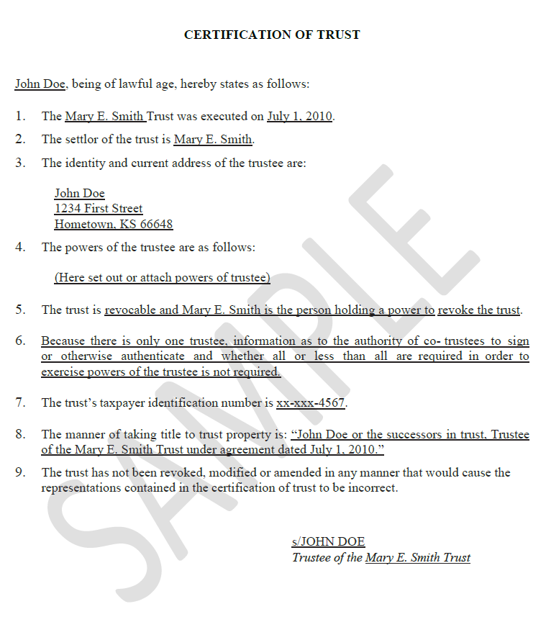
Kansas Form Certificate of Trust

Slide 37
Obtaining Information to Verify Authority – Colorado – Statement of Authority
C.R.S. 38-30-172 allows for a Statement of Authority to be filed of record with the County Clerk and Recorder’s office
Statement of Authority is an instrument executed on behalf of an entity (“entity” is defined in C.R.S. 2-4-401(8) to mean a trust) that contains:

Slide 38
Colorado – Statement of Authority
The name of the entity;
The type of entity and the state, country, or other governmental authority under which it was formed
Mailing address for the entity; and
Name or position of the person authorized to execute instruments conveying, encumbering, or otherwise affecting title to real property on behalf of the entity

Slide 39
Colorado – Statement of Authority
A recorded Statement of Authority is prima facie evidence of the authority of person that executed an instrument on behalf of an entity
The absence of any limitation that may exist upon the authority of the person named in or holding the position described in the recorded Statement of Authority is prima facie evidence that no limitations exist

Slide 40
Trusts 101 – Modification and Termination of a Trust
Generally, a trust will terminate automatically at the expiration of the trust term specified in the instrument
A trust will also terminate when all of the purposes of the trust have been accomplished or the purposes of the trust have become unlawful, contrary to public policy, or impossible to achieve

Slide 41
Trusts 101 - Modification and Termination
By the settlor
The settlor can revoke or amend a trust unless the terms expressly state the trust is irrevocable
Upon revocation, the trustee must distribute the property in accordance with the settlor’s instructions

Slide 42
Trusts 101 - Modification and Termination
By the beneficiaries
A trust may be terminated or modified upon the consent of the settlor or her agent, conservator, or guardian, and all beneficiaries even if the modification conflicts with a material purpose of the trust

Slide 43
Trusts 101 - Modification and Termination
By the beneficiaries
A trust may be terminated or modified on the consent of all the beneficiaries (and without the consent of the settlor), but only if no material purpose of the trust would be frustrated by termination
Fulfillment of the trust’s purposes is seen as the equivalent of the settlor’s consent

Slide 44
Trusts 101 - Modification and Termination
Trust can also be modified or terminated:
By a court for unanticipated circumstances, in the event of an uneconomic trust or tax purpose, or to reflect the settlor’s intent
By the trustee for an uneconomic trust (corpus is less than $50,000 and amount is insufficient to justify cost of administration) or to combine or divide trusts, absent contrary terms in the trust

Slide 45
Third Parties Duty to a Trust
When we know property is held in a trust (e.g., the existence of the trust appears on the face of the document representing the property), courts generally hold that the third party has a duty to inquire into the trustee’s authority.

Slide 46
Third Parties Duty to a Trust
Because the third party has a duty to inquire, the third party will be charged with such information as a reasonable inquiry would produce.
Some cases and many statutes relieve persons dealing with trustees of the duty to inquire into the propriety of the trustee’s actions.

Slide 47
Example One - Question
Archie and Olivia established a trust (which is of record in Weld County, CO) in which they conveyed minerals to Roger for the benefit of Cooper, Peyton, and Eli. The trust provides that upon the death of Archie and Olivia, the trust property shall vest in Cooper, Peyton, and Eli. Archie and Olivia have passed, and Certificates of Death are filed of record for both in Weld County. Is a conveyance from Roger, as Trustee, necessary in order to vest title in Cooper, Peyton, and Eli?

Slide 48
Example One - Answer
No. Because the trust instrument that specifies vesting of the trust property in the beneficiaries is of record, and because the occurrence of the event is established of record, no Trustee’s Deed is required.

Slide 49
Example Two - Question
Dick established a trust (which is of record in Lincoln County, CO) in which he conveyed minerals to Jeff and Walt, as Co-Trustees, for the benefit of LaTroy, Troy, and Carlos. The trust provides that upon the death of Dick, Jeff and Walt shall manage the property until, in their discretion, LaTroy, Troy, and Carlos are mature enough to own the property outright, at which time the trust property shall vest in LaTroy, Troy, and Carlos. Dick is deceased, and a Certificate of Death is filed of record. Is a conveyance from Jeff and Walt, as Co-Trustees, necessary in order to vest title in LaTroy, Troy, and Carlos?

Slide 50
Example Two - Answer
Yes. Unlike example One, in this scenario, title to the corpus does not automatically vest in LaTroy, Troy, and Carlos upon Dick’s death. Rather in this scenario, the instrument requires that Jeff and Walt exercise their discretion to determine that the beneficiaries are capable of managing the trust property prior to vesting of ownership. Therefore, due to the intervening event prior to vesting, a Trustee’s Deed into the three beneficiaries is required.

Slide 51
Trusts 101 – How Trusts Can Make our Jobs Easier
Trusts allow for easier conveyancing, i.e., leasing, of minerals for development
Compare and contrast the following two situations:

Slide 52
How Trusts May Make our Jobs Easier
Phil and Nancy convey the farm to their three children and their respective spouses for their natural lives, and then to their eleven grandchildren
Phil and Nancy convey the farm to Warren, in trust, for the benefit of their eleven grandchildren

Slide 53
How Trusts May Make our Jobs Easier
In the first situation, a lessee would typically need to approach each present estate owner (the life tenants) and each future interest holder (the remaindermen) to execute an oil and gas lease. That is possibly 17 lessors!
In the second situation, a lessee needs only to approach Warren, the Trustee, to obtain the lease (with verification of authority)

Slide 54
Questions?
Clinton M. Goos
cgoos@bwenergylaw.com
Phone: 303.407.4499
Direct: 303.407.4493
Cell: 316.617.2681

